Slide 1


Introduction To Node.Js
Created in 2009 by Ryan Dahl, this JavaScript runtime environment is popular for developing scalable network applications and server-side scripts.

Slide 2
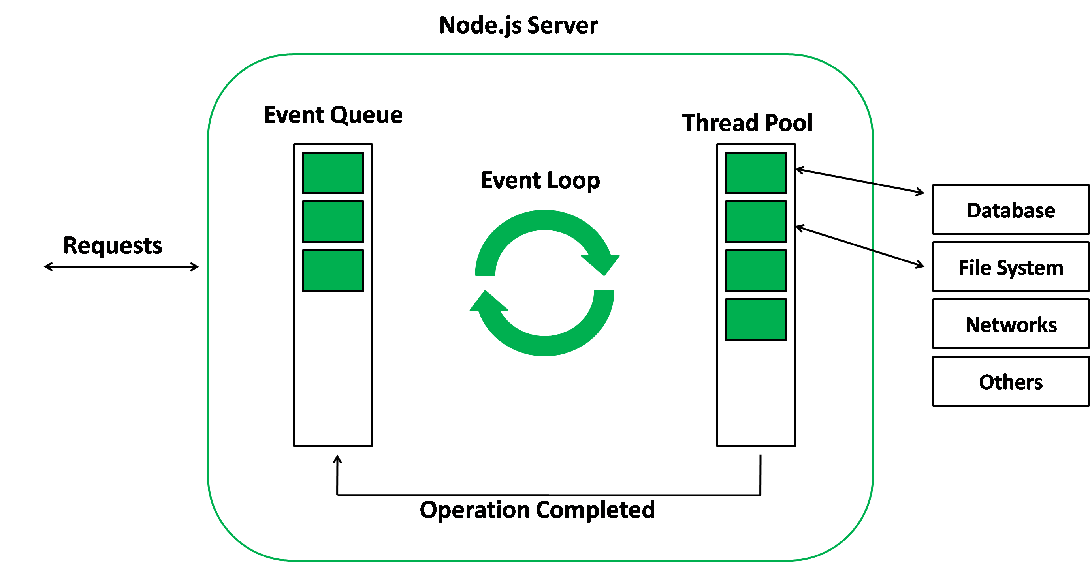
Event Loop In Node.Js
1
Timers
Set timeouts and intervals.
2
I/O Callbacks
Handle asynchronous I/O operations.
3
Poll
Wait for I/O events.
4
Check
Execute callbacks after I/O events.
5
Close Callbacks
Handle closing of resources.

Slide 3
Threads And Concurrency In Node.Js
Handling Requests
Event-driven
Node.js uses a single thread to manage multiple connections through asynchronous I/O.
No Context Switching
No contention and no context switches, thus more efficient.
Comparison
Multithreading environments often block requests, whereas Node.js processes the next event using queues.

Slide 4
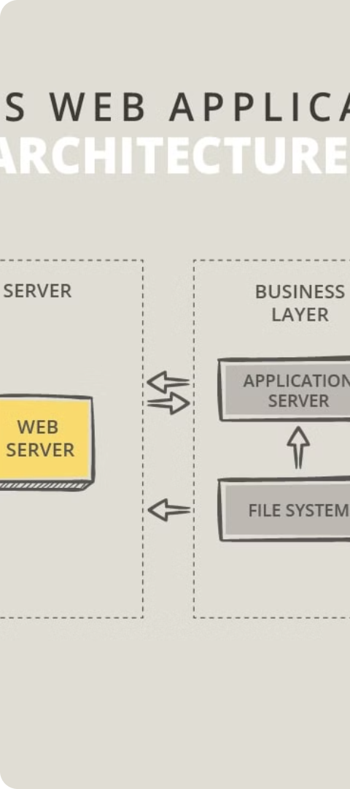
The Architecture Of Node.Js
1
V8 JavaScript Engine
2
Event-driven, Non-blocking I/O Model
Built on Google's V8 engine which translates JavaScript code into machine code.
Enables Node.js to handle a large number of concurrent connections efficiently.
3
Event Loop
Monitors and processes I/O operations to maintain application responsiveness.

Slide 5
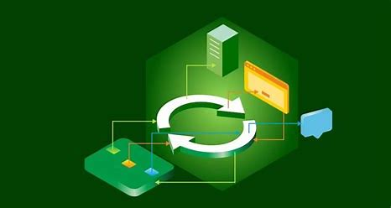
Blocking Vs Non-Blocking I/O
Blocking I/O
Non-blocking I/O
Program waits until the operation completes.
Node.js handles I/O operations without blocking the
main execution thread.

Slide 6

The File System (Fs) Module In Node.Js
Allows reading, writing, deleting, and managing files and directories.
Synchronous Methods
Asynchronous Methods
Block the event loop until the operation completes.
fs.readFileSync() and fs.writeFileSync()
Use callbacks or promises to handle the results without blocking the event loop.
fs.readFile() and fs.writeFile()

Slide 7




The Http Module In Node.Js
HTTP Server
Routing Logic
Incoming Requests
Outgoing Requests
Set up an HTTP server.
Define routing logic.
Handle incoming requests.
Fetch data from external sources.

Slide 8




Introduction To Express.Js
Middleware-based Architecture
Web Servers
Routing
Error Handling
Quickly set up web servers.
Define routing rules.
Handle errors.
Extends and customizes the functionality of applications.

Slide 9
Installing And Setting Up Express.Js
1
Install Express.Js
Run npm install express.
2
Create A New Express.Js Application
Require the 'express' module and call the express() function.
3
Configure Application Settings
Set the port number, view engine, and middleware.

Slide 10
Common Response Methods
res.send()
res.json()
Sends a string, buffer, object, or array.
Sends a JSON response.
res.sendFile()
res.render()
Sends a file from the file system.
Renders a view file.

Slide 11
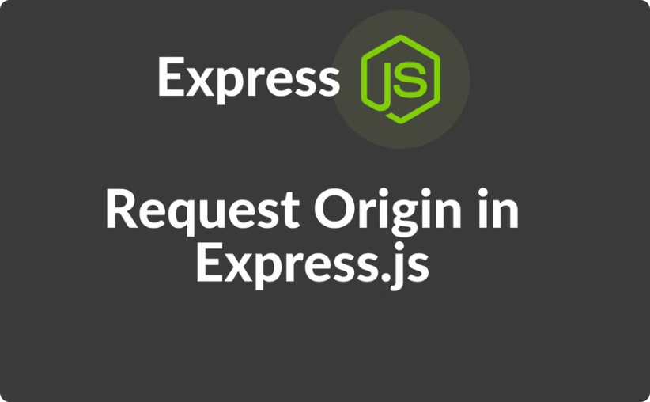

Routing And Middleware In Express.Js
Route Handlers
Middleware System
Create route handlers for different HTTP methods.
Perform tasks such as parsing request bodies, logging requests, and handling errors.

